Slide 1
Spatio-Temporal Analysis of Road Traffic Crashes in Kenya: Evidence from Geo-Referenced Accident Reports (2017-2018)
A Descriptive – Research study
Lorna Kendi
Registration number: AST/0222/23
Supervisor:

Slide 2
Table of Contents
Background of the Study
Problem Statement
Objectives of the Study
Data and Study Area
Methodology
Results
Interpretation & Discussion
Conclusions
Recommendations

Slide 3
Background of the Study
Road traffic accidents are a major public safety problem in Kenya
Crashes result in high numbers of injuries and deaths each year
Pedestrians and motorcyclists are the most vulnerable road users
Accidents vary by location and time of occurrence
Limited use of spatial and statistical analysis in safety planning
This study uses geo-referenced crash data to support evidence-based road safety decisions

Slide 4
Problem Statement
Road traffic accidents remain a major public safety problem in Kenya
High levels of fatalities, injuries, and economic losses persist
Crashes are especially common in urban areas and along major highways
Pedestrians and motorcyclists are disproportionately affected
Road safety interventions lack strong data-driven and spatial evidence
Limited use of geo-referenced data to identify hotspots, time patterns, and fatality risks
This study uses spatio-temporal and severity analysis to support evidence-based road safety planning
Notes:
notes

Slide 5
Objectives of the Study
General Objective
To analyze the spatial, temporal, and severity patterns of road traffic accidents in Kenya using geo‑referenced crash data in order to inform evidence‑based road safety interventions.
Specific objectives
To analyze when road accidents occur (by hour, day, and month)
To identify accident hotspot locations across Kenya
To examine how road user types (pedestrians, motorcyclists, matatus) relate to crash fatality
To determine factors influencing fatal crashes using correlation and logistic regression
To provide data‑driven insights and policy recommendations to improve road safety in Kenya
Notes:
These are the objectives

Slide 6
Data and Study Area
The study uses secondary data from World Bank Open Data on road traffic accidents in Kenya from 2017-2018. (https://data.worldbank.org/country/kenya )
It includes key variables such as:
Location (latitude and longitude)
Time and date of accidents
Road user type involved
Crash severity (fatal or non‑fatal)
The data are suitable for analyzing spatial, temporal, and severity patterns of accidents.
Data were cleaned and processed to improve accuracy and consistency.
The final dataset was used for spatial analysis, correlation analysis, and logistic regression.

Slide 7
Methodology
- Obtained secondary road accident data for Kenya
- Removed records with missing or incomplete key information
- Prepared variables for analysis
Data Cleaning
- Summarized accidents by hour, day of week, and month
- Examined crash frequency and severity patterns
- Analyzed distribution by road user categories
Descriptive Analysis
- Used latitude and longitude to map accident locations
- Identified high‑risk areas using hotspots
- Visualized spatial distribution of crashes across Kenya
Spatial Analysis
- Examined relationships between road user types, time factors, and crash severity
- Identified key variables associated with fatal accidents
Correlation Analysis
- Modeled the likelihood of a crash being fatal or non‑fatal
- Assessed the effect of road user category and other factors on fatality risk
Binary Logistic Regression

Slide 8
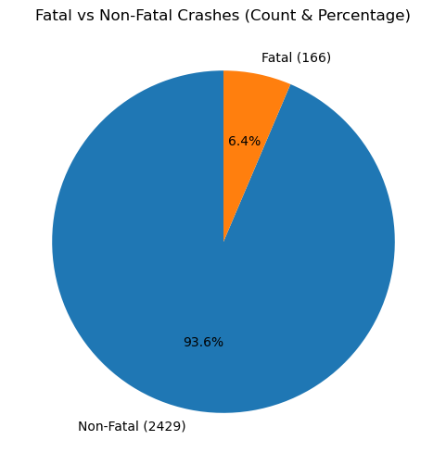
Descriptive Results
Distribution of Road Traffic Accidents by Crash Severity
The figure shows the proportion of fatal and non‑fatal road traffic accidents. The results indicate that non‑fatal accidents constitute a larger share of the total accidents, while fatal accidents represent a smaller proportion.

Slide 9
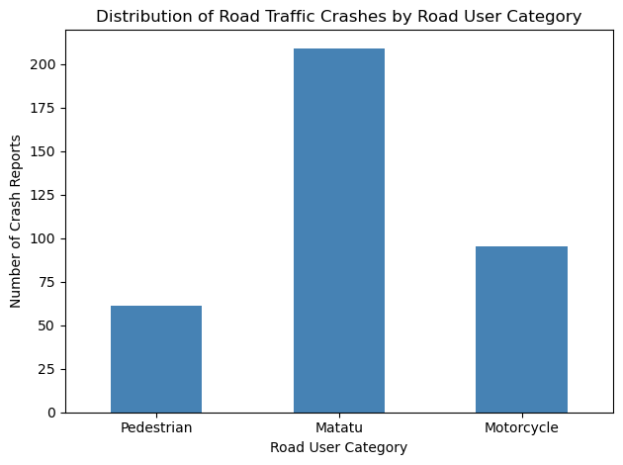
Distribution of Road Traffic Crashes by Road User Category
Figure 2 illustrates the distribution of road traffic crashes by road user category. The findings indicate that matatu‑related crashes account for a substantial proportion of reported accidents, followed by motorcycle‑related crashes, while pedestrian‑related crashes constitute a smaller share of the total crash reports

Slide 10
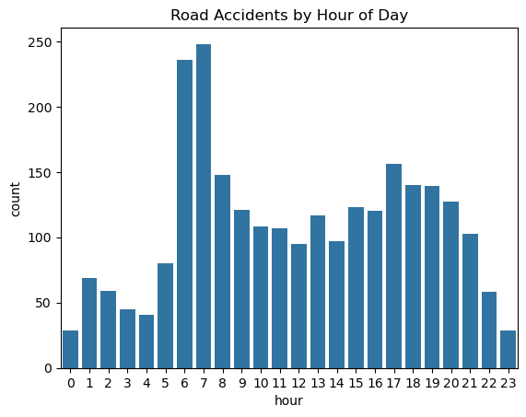
Distribution of Road Accidents by Hour of Day
Figure shows that accident occurrences are relatively low during the late night and early morning hours (midnight to about 4:00 a.m.), which may be attributed to reduced traffic volume during these hours. A sharp increase in accidents is observed during the early morning hours between 6:00 a.m. and 8:00 a.m., corresponding to the morning rush hour when traffic volume is high and road users are commuting to work and school.

Slide 11
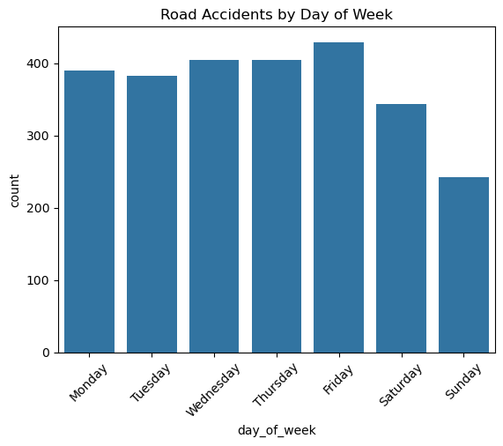
Distribution of Road accidents by day of the week
Figure shows that accidents happen more on weekdays than on weekends. From Monday to Friday, accident numbers are high, with Friday having the most accidents. This is likely because there is more traffic during workdays and increased movement toward the end of the week. Accidents drop on Saturday and are lowest on Sunday. This is probably due to less traffic and fewer work and business activities.

Slide 12
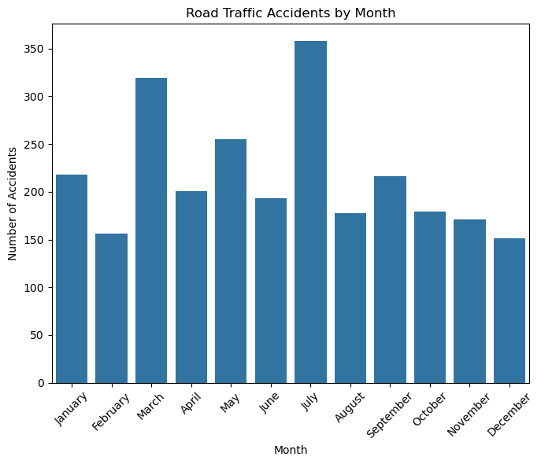
Distribution of road accidents by month
Figure shows that the monthly distribution of reported road traffic accidents in Kenya. Accident occurrences vary across the year, with noticeable peaks around March and July, and lower counts towards the end of the year, particularly in December. These patterns may be associated with seasonal factors such as increased travel during school terms, long-distance transport activities, weather conditions, and variations in traffic volume. Overall, the figure highlights clear temporal (monthly) variation in road traffic accidents in Kenya, underscoring the importance of time-based road safety interventions.

Slide 13
Severity and Risk analysis
Fatality vs Motorcyclists
Fatality vs Pedestrians
motorcyclist involved | No | Yes
fatal
No | 94.12 | 80.0
Yes | 5.88 | 20.0
Contains pedestrians | No | Yes
fatal
No | 94.277822 | 65.57377
Yes | 5.722178 | 34.42623
Fatality vs Matatu
contains_matatu_words | 0 | 1
contains_fatality_words
0 | 93.629505 | 93.301435
1 | 6.370495 | 6.698565

Slide 14
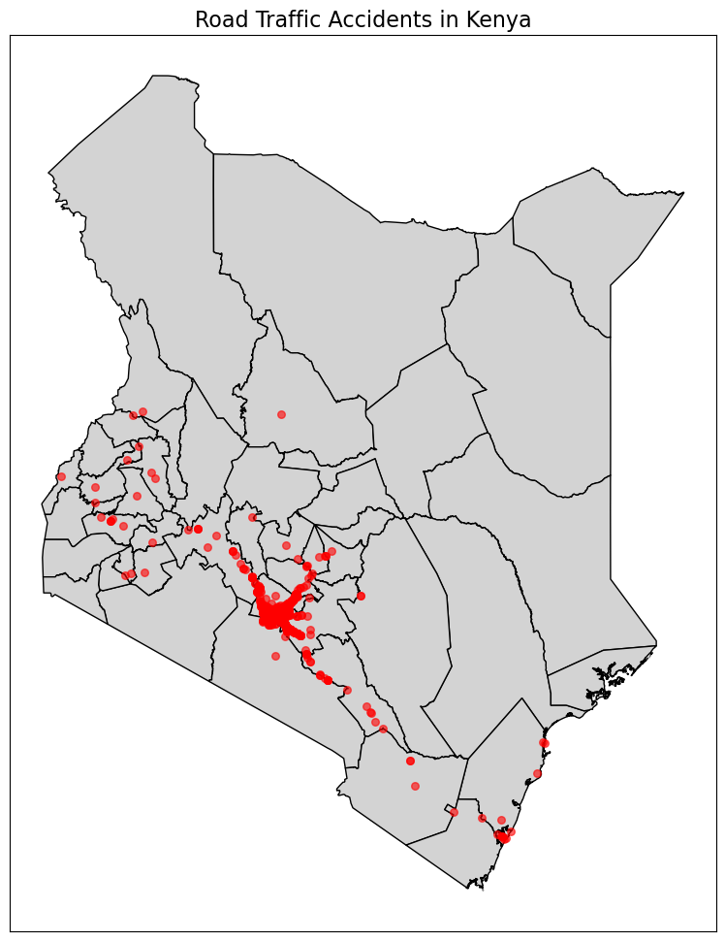
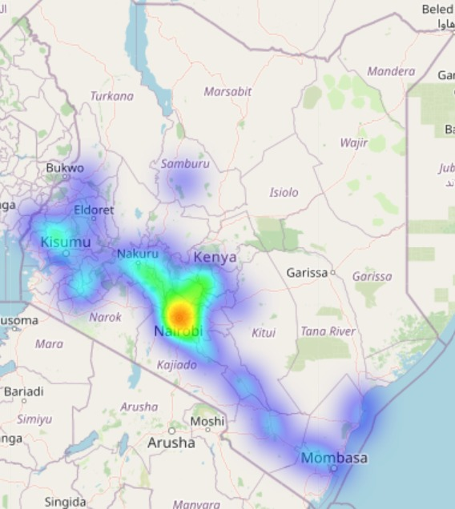
Spatial Distribution
Heat map of Road accidents in Kenya

Slide 15
Spatial Analysis Results
Most accidents cluster around major cities (Nairobi, Mombasa, Kisumu) due to high traffic volumes and interactions between road users.
Primary hotspots: Nairobi, Kiambu, Machakos, Mombasa
secondary hotspots along major highways (Mombasa–Nairobi, Nairobi–Eldoret).
Northern/northeastern regions (Turkana, Marsabit) have fewer accidents due to low population and traffic.
Accidents concentrate in high-traffic areas; pedestrians, public transport, and private cars are most affected. Suggests need for traffic management, pedestrian crossings, and speed control.
Major highways and intersections are secondary hotspots, with accidents linked to higher speeds, dense traffic, and complex road designs.

Slide 16
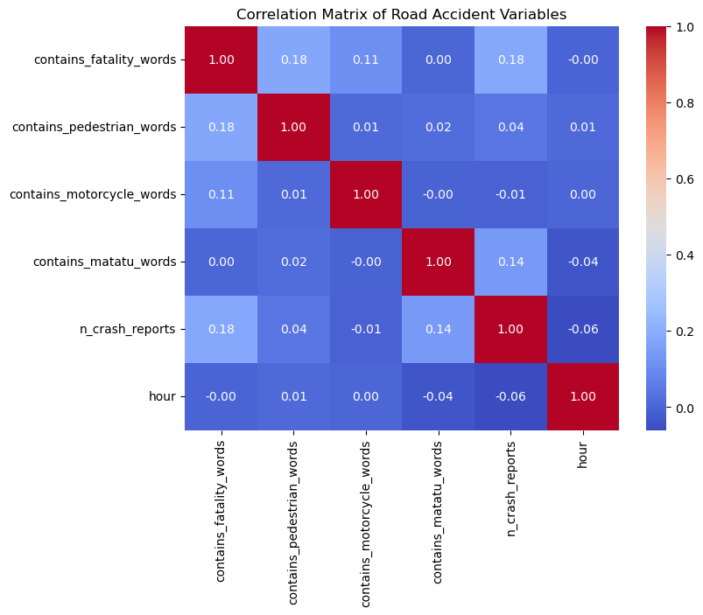
Correlation Analysis
Overall: Most correlations are very weak → factors largely independent.

Slide 17
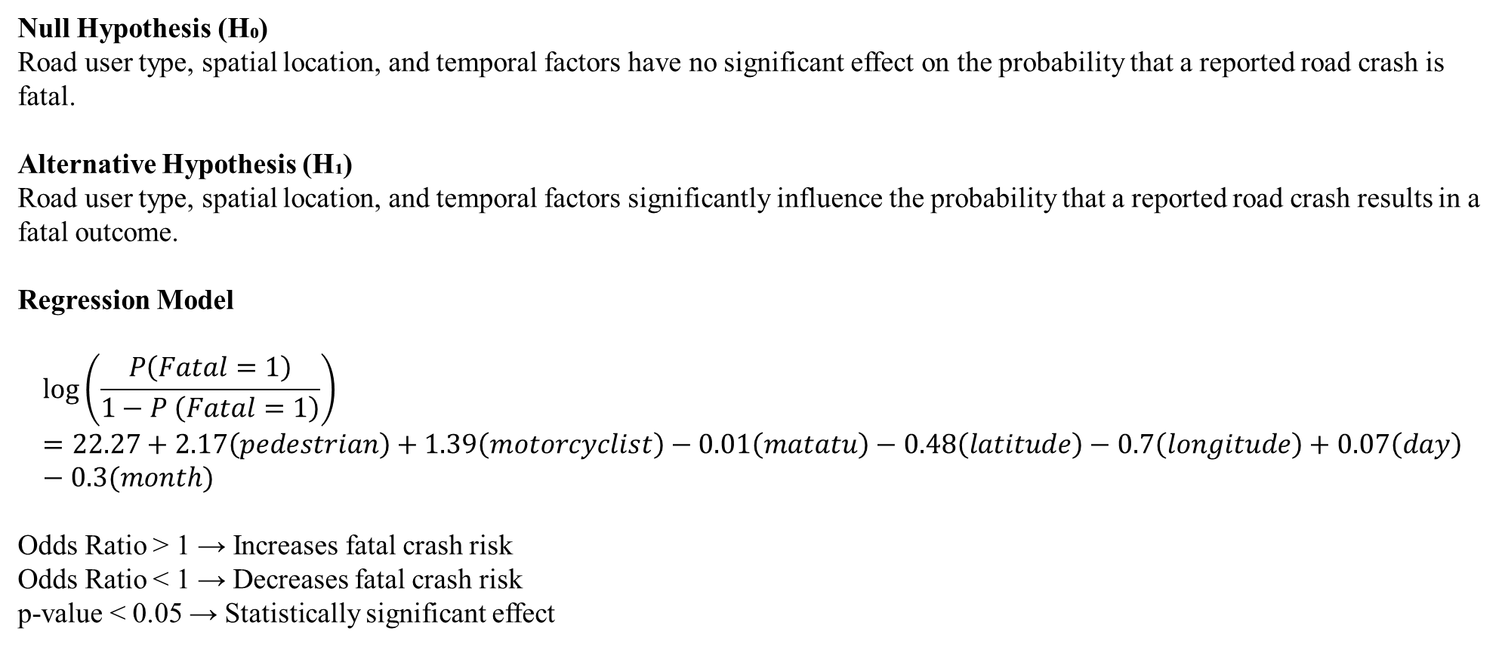
Logistic Regression Results
Null Hypothesis (H₀)
Road user type, spatial location, and temporal factors have no significant effect on the probability that a reported road crash is fatal.
Alternative Hypothesis (H₁)
Road user type, spatial location, and temporal factors significantly influence the probability that a reported road crash results in a fatal outcome.
Regression Model
$$\log\left(\frac{P\left(Fatal=1\right)}{1−P \left(Fatal=1\right)}\right)=22.27+2.17\left(pedestrian\right)+1.39\left(motorcyclist\right)−0.01\left(matatu\right)−0.48\left(latitude\right)−0.7\left(longitude\right)+0.07\left(day\right)−0.3(month)$$
Odds Ratio > 1 → Increases fatal crash risk
Odds Ratio < 1 → Decreases fatal crash risk
p-value < 0.05 → Statistically significant effect

Slide 18
Logistic Regression cont’d
Variable | Odds Ratio (OR) | 95% Confidence Interval | Significance | Interpretation
Pedestrian | 8.72 | [4.97, 15.32] | Significant | Crashes involving pedestrians have about 9 times higher odds of being fatal compared to crashes not involving pedestrians, holding other factors constant. This reflects high vulnerability due to lack of physical protection.
Motorcyclist | 4.00 | [2.32, 6.90] | Significant | Motorcyclist-involved crashes have approximately 4 times higher odds of fatality, indicating elevated risk associated with motorcycle use and limited protective barriers.
Matatu | 0.99 | [0.55, 1.79] | Not significant | Although matatus are involved in many crashes, their involvement does not significantly affect the likelihood of a fatal outcome per crash, suggesting high crash frequency but lower severity.
Latitude | 0.62 | [0.20, 1.89] | Not significant | North–south location differences do not independently influence fatal crash risk after controlling for other factors.
Longitude | 0.50 | [0.20, 1.25] | Not significant | East–west spatial variation shows no statistically significant association with fatal crash occurrence.
Day of Week | 1.07 | [0.99, 1.17] | Not significant | The day of occurrence has no meaningful effect on the probability of a crash being fatal.
Month | 0.97 | [0.92, 1.02] | Not significant | Fatal crash risk does not vary significantly across months, suggesting limited seasonal effects in this dataset.
Constant | 4.7 × 10⁹ | Very wide CI | Not interpreted | The intercept represents baseline log-odds and has no direct practical interpretation in this context.

Slide 19
Negative Binomial Regression Results and Discussion
Variable | Coefficient | p-value | Interpretation
Intercept (const) | 0.5461 | 0.000 | Baseline crash count when all predictors = 0.
Pedestrian | 0.3484 | 0.026 | Crashes mentioning pedestrians are associated with a 41.7% increase in crash counts. Significant
Matatu | 0.5827 | 0.000 | Crashes involving matatus are associated with a 79% increase in crash counts. significant
Motorcycle | -0.0500 | 0.713 | No statistically meaningful effect.
Hour | -0.0145 | 0.001 | Every increase in hour (later in the day) slightly reduces crash counts by ~1.4%.
Day of Week | -0.0213 | 0.110 | Not statistically significant.
Month | 0.0147 | 0.064 | Weak/ borderline effect; may show slight seasonality.

Slide 20
Discussion of Findings
Overall Crash Patterns: Most road crashes in Kenya are non‑fatal, but fatal crashes remain a serious public safety concern.
Temporal Patterns: Crashes peak during morning and evening rush hours, reflecting high traffic congestion and risky driving periods.
Severity & Vulnerable Road Users: Pedestrians and motorcyclists face a much higher risk of fatal injury compared to other road users.
Spatial Distribution: Crash hotspots are concentrated in urban areas and along major highways with heavy traffic flow.
Correlation Analysis: Crash characteristics show weak relationships, indicating fatalities result from multiple interacting factors rather than one cause.
Logistic Regression Findings: Road user type—especially pedestrians and motorcyclists—is the strongest predictor of fatal crash outcomes.
Negative Binomial Findings: Pedestrian and matatu involvement significantly increases crash counts, and the NB model provides more reliable estimates by accounting for overdispersion.

Slide 21
Limitations of the study
Relies on secondary, crowdsourced Ma3Route data → possible underreporting and reporting bias
Lacks official police/hospital records → fatalities and injuries not medically verified
Accident locations based on user-reported coordinates → possible location inaccuracies
Excludes road infrastructure factors (road condition, lighting, signage, traffic volume)
Limited to the dataset time period → may not reflect long-term accident trends
Does not account for driver behavior (speeding, alcohol use, driver experience)

Slide 22
Conclusions
Road traffic crashes in Kenya show clear spatial and temporal patterns, with higher concentrations in urban areas and major highways
Matatus are involved in the highest number of crashes, but most are non‑fatal
Pedestrians and motorcyclists face the highest risk of fatal outcomes, highlighting their vulnerability
Crash severity is driven more by road user type than by time or location
Spatial hotspot analysis is effective for identifying priority areas for intervention
The Negative Binomial model provided more reliable estimates by accounting for overdispersion
Improving safety for vulnerable road users is key to reducing road traffic fatalities in Kenya

Slide 23
Recommendations
Improve pedestrian infrastructure in high‑risk urban areas and highways
Strengthen motorcycle safety through helmet enforcement, training, and visibility measures
Implement targeted interventions in identified crash hotspots
Enhance traffic law enforcement on speed, alcohol use, and vehicle safety
Strengthen regulation and oversight of public transport (matatus)
Improve crash data collection and geo‑referenced reporting
Align road safety planning with high‑risk times (peak hours and seasons)
Expand public awareness campaigns focused on vulnerable road users

